Slide 1
Predictive Maintenance of Industrial Machinery
CAPSTONE PROJECT
Problem Statement NO.39
Presented By:
Sahil Kadam - B.K Birla College Kalyan - Data Science

Slide 2
OUTLINE
Problem Statement
Proposed System/Solution
System Development Approach
Algorithm & Deployment
Result (Output Image)
Conclusion
Future Scope
References

Slide 3
Problem Statement
Develop a predictive maintenance model for a fleet of industrial machines to anticipate failures before they occur. This project will involve analyzing sensor data from machinery to identify patterns that precede a failure. The goal is to create a classification model that can predict the type of failure (e.g., tool wear, heat dissipation, power failure) based on real-time operational data. This will enable proactive maintenance, reducing downtime and operational costs.

Slide 4
Proposed Solution
Developed a machine learning model that identifies the failure type in machinery using the dataset provided. The model will process all the key measurements to identity the type of failure rapidly and accurately. This classification will help detect fault in machinery based on certain conditions and assist in improving the Machineries.
Key components:
Data Collection: Use the Kaggle dataset on Industrial Machine Failure.
Data Pre-processing: Clean and normalize the dataset.
Machine Learning Algorithm:
Implemented a machine learning algorithm, such as forecasting model to predict maintenance of industrial machinery based on historical patterns.(Rando Forest Classifier).
Considered factors like Air temperature, Process temperature, Rotational speed, Torque, Tool wear and target or prediction accuracy.
Deployment:
Deployed using cloud technology.
Used the IBM Cloud to deploy the solution on a scalable and reliable platform, considering factors like server infrastructure, response time, and user accessibility.
Evaluation:
Validated the model using accuracy and predictive strength.
Continuous monitoring of prediction accuracy.

Slide 5
System Approach
The "System Approach" section outlines the overall strategy and methodology for developing predictive model and implementing the type of failure in machinery . Here's a suggested structure for this section:
System requirements:
IBM Cloud(Mandatory).
IBM Watson x studio for model development and deployment.
IBM cloud object storage for dataset handling.

Slide 6
Algorithm & Deployment
Algorithm Selection :
Random Forest Classifier which will use multiple decision trees to predict outcomes,like identifying types of machine failures.
Data Input :
Air temperature, Process temperature, Rotational speed, Torque, Tool wear and phasor measurements from the dataset.
Training Process:
Learning using labeled Failure types.
Prediction Process:
Model deployed on IBM Watson Studio with pipeline 4 for accurate predictions.

Slide 7
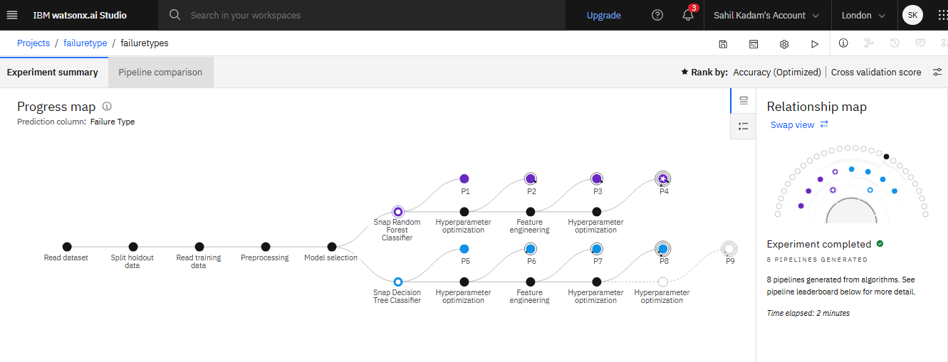
Result

Slide 8
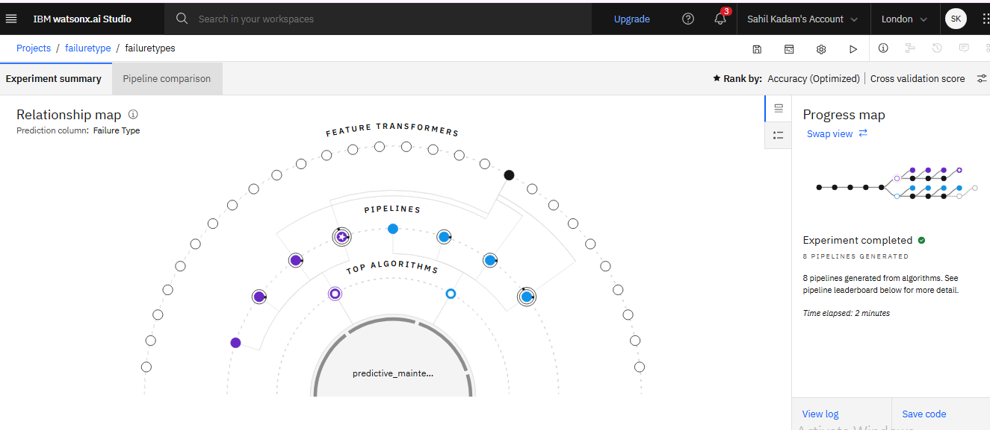
Result

Slide 9
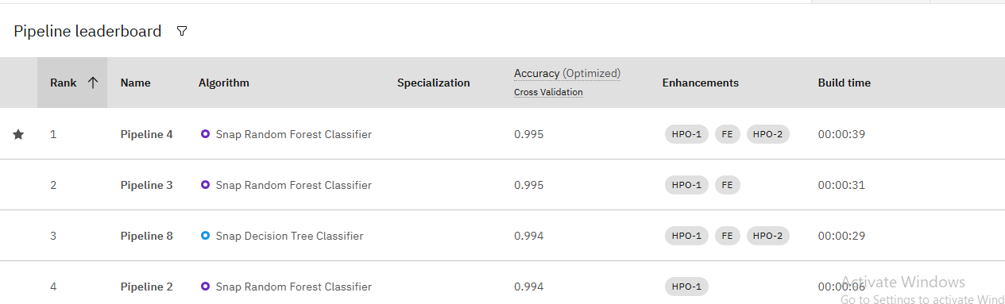
Result

Slide 10
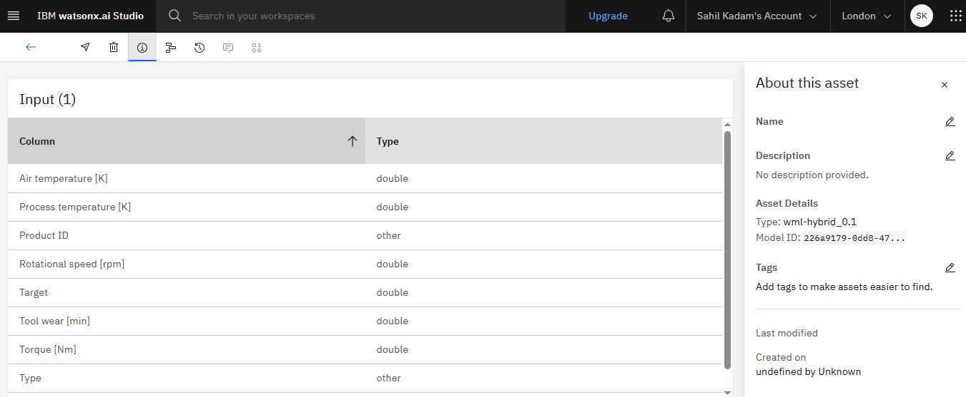
Result

Slide 11
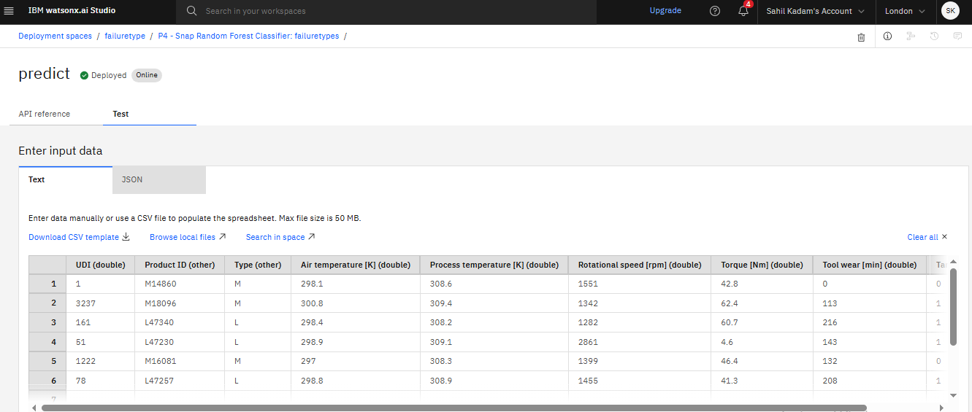
Result

Slide 12
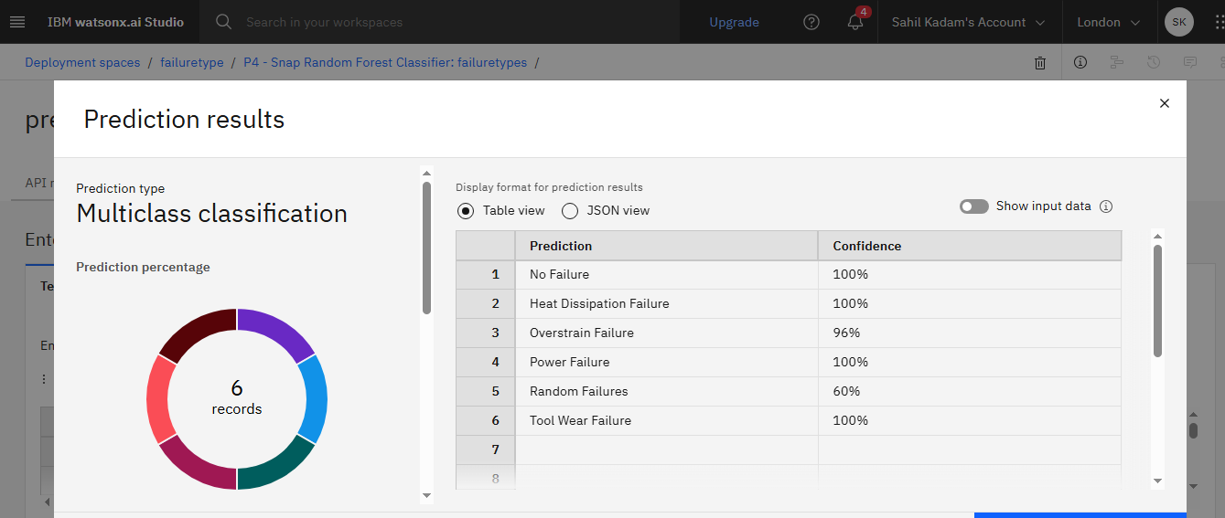
Result

Slide 13
Conclusion
The predictive maintenance model was successfully developed using Random Forest Classifier, utilizing features like Air temperature, Torque, Rotational Speed, and Tool Wear.
The model accurately predicts the type of failure in industrial machines,based on the give inputs.
Deployment on IBM Watson Studio ensured scalability and accessibility with real-time prediction along with the confidence level in percentages .
Challenges faced included maintaining model performance during deployment.
Overall, the solution demonstrates how machine learning and cloud platforms can drive cost-effective and reliable industrial operations.

Slide 14
Future scope
Implement Auto ML to enhance model accuracy and automate feature selection for improved failure prediction.
Dashboard Integration: Develop an interactive dashboard for operators to monitor predictions and machine health in real-time.
Industry Application: Expand the predictive maintenance system for use in automotive, energy, and aviation sectors.
Smarter Models: Use AutoML to make the system better at predicting failures with less manual work.
Easy Monitoring Tool: Will Build a clear, user-friendly screen for workers to see machine status and predictions at a glance.

Slide 15
References
This project is being carried out under the leadership and mentorship of Edunet Foundation and IBM Cloud:
IBM Cloud Services https://www.ibm.com/cloud
IBM Watson Studio https://www.ibm.com/cloud/watson-studio
IBM Cloud Object Storage https://www.ibm.com/cloud/object-storage
Kaggle Dataset on Power System Faults https://www.kaggle.com

Slide 16
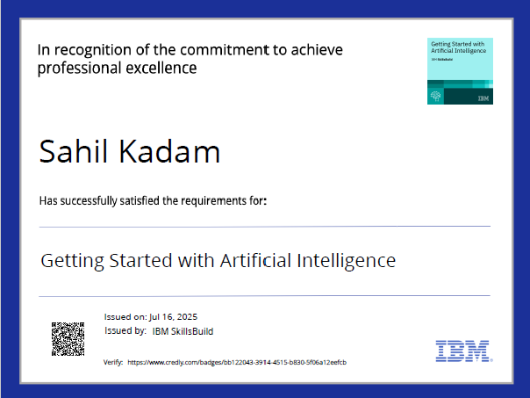
IBM Certifications
Screenshot/ credly certificate( getting started with AI)

Slide 17
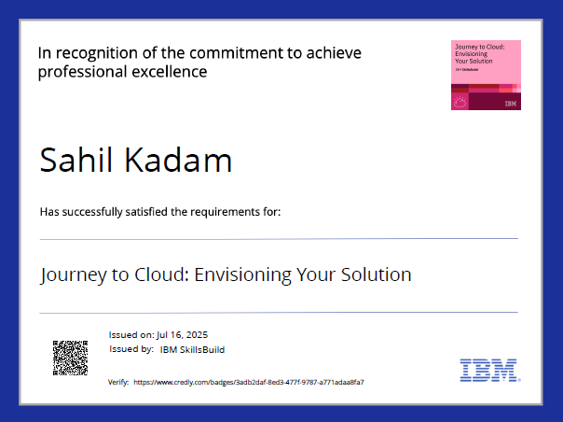
IBM Certifications
Screenshot/ credly certificate( Journey to Cloud)

Slide 18
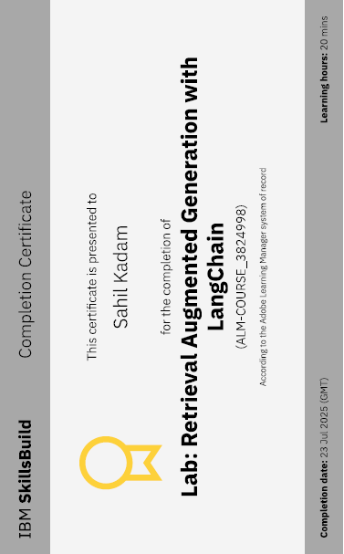
IBM Certifications
creenshot/ credly (certificateRAG Lab)

Slide 19
THANK YOU

